Slide 1


Cyclistic Bike-Share Analysis
PREPARED BY VAIBHAV KUMAR

Slide 2



Hello
https://www.linkedin.com/in/vaibhav-kumar1805/
I AM VAIBHAV
vaibhav.kumar.180500@gmail.com
https://github.com/Vaibhav-180500?tab=repositories

Slide 3

Project Purpose
The project's purpose is to analyze how casual riders and annual members use Cyclistic bikes differently in order to design a new marketing strategy that converts casual riders into annual members.

Slide 4
Executive Summary
DATA USED
For the month of January, February and March, 2023
HYPOTHESIS
Annual members tend to use the bikes for longer durations per ride than casual riders.
Annual members are more likely to use the same bike station for pick-up and drop-off, while casual riders tend to use different stations.
There may be certain demographics or geographic areas where casual riders are more prevalent and where targeted marketing efforts could be effective in converting them to annual members.

Slide 5
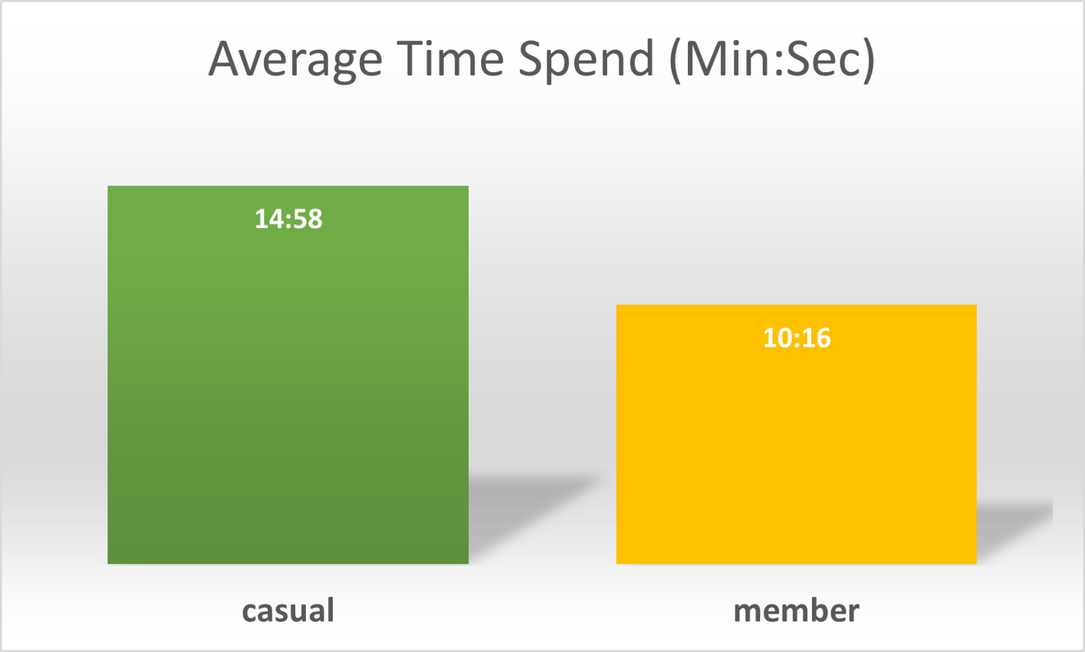
Key Findings : Average Ride Length
Casual Riders ride ~1.5 times more than Members
This may suggest that casual riders are using the bikes for leisurely activities and may not necessarily have a specific destination in mind. In contrast, annual members may be using the bikes for commuting or other utilitarian purposes, where they need to reach a specific destination within a certain timeframe.

Slide 6
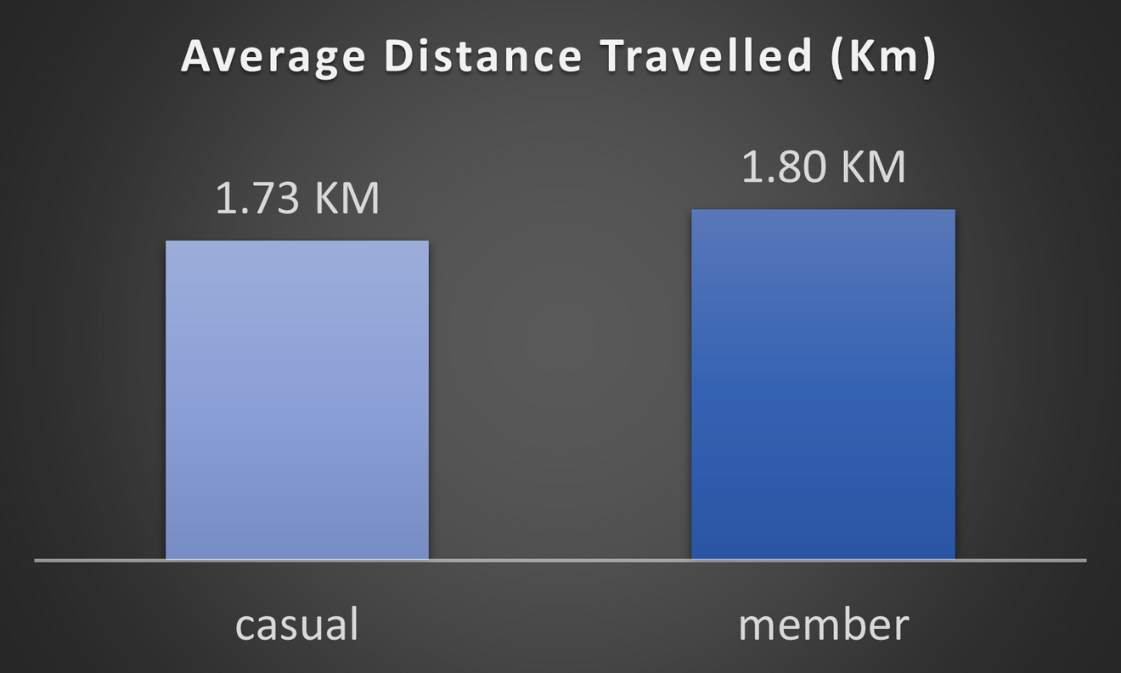
Key Findings : Average Ride Length
(70 M)
A very slight difference in distance travelled by a Casual Rider and a Member.
It's possible that there are some annual members who travel very long distances, skewing the average distance higher. In contrast, casual riders may be more likely to take short trips, which would lower their average distance traveled.

Slide 7
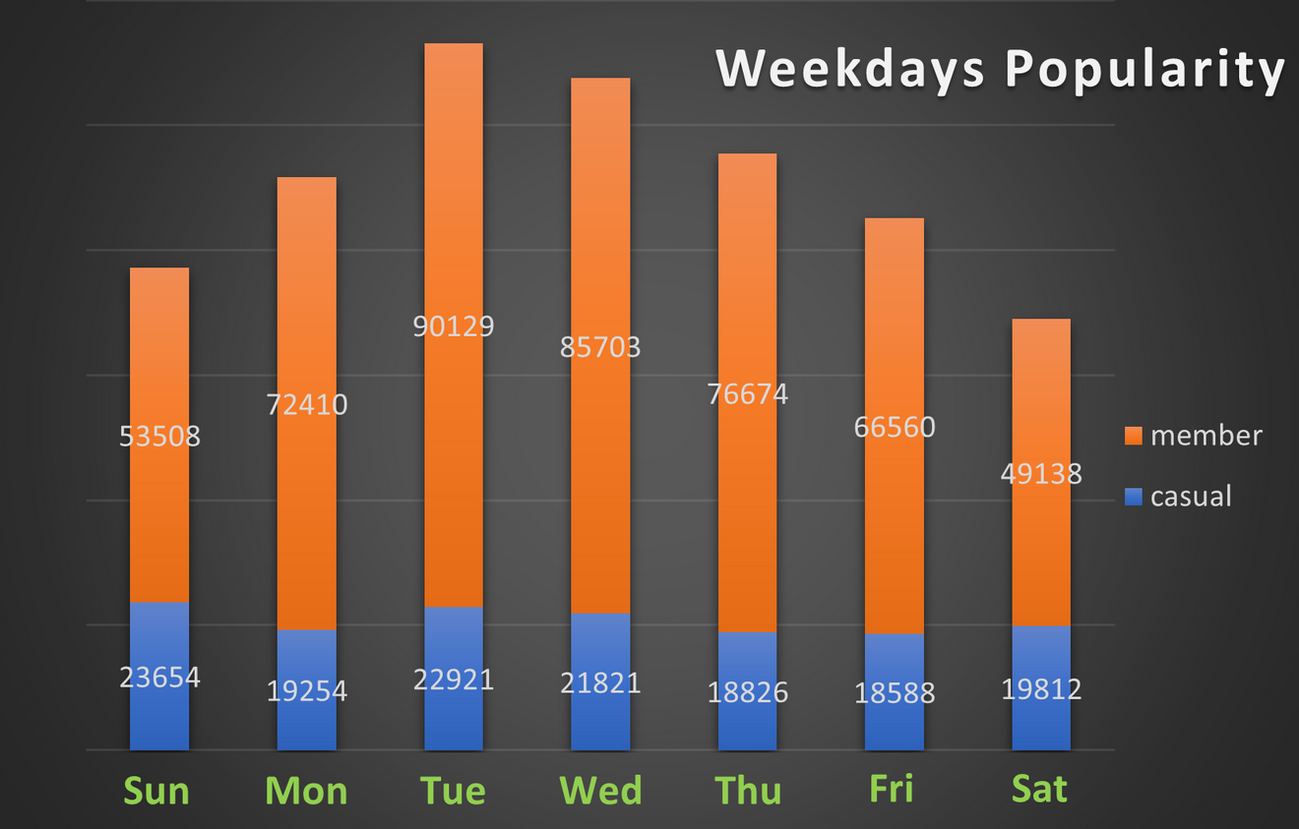
Key Findings : Popular Weekdays
For Member, Tuesday is the most popular day to take a bike which gradually decreases towards weekend.
For Casual Riders, Sunday is the most popular day to take a bike and the popularity difference was not very different.
Members are more likely to use the bikes for commuting or other weekday activities, rather than weekend leisure activities. Where as casual riders may be more likely to use the bikes for weekend leisure activities, such as sightseeing or exploring the city and are more flexible with their riding schedules

Slide 8
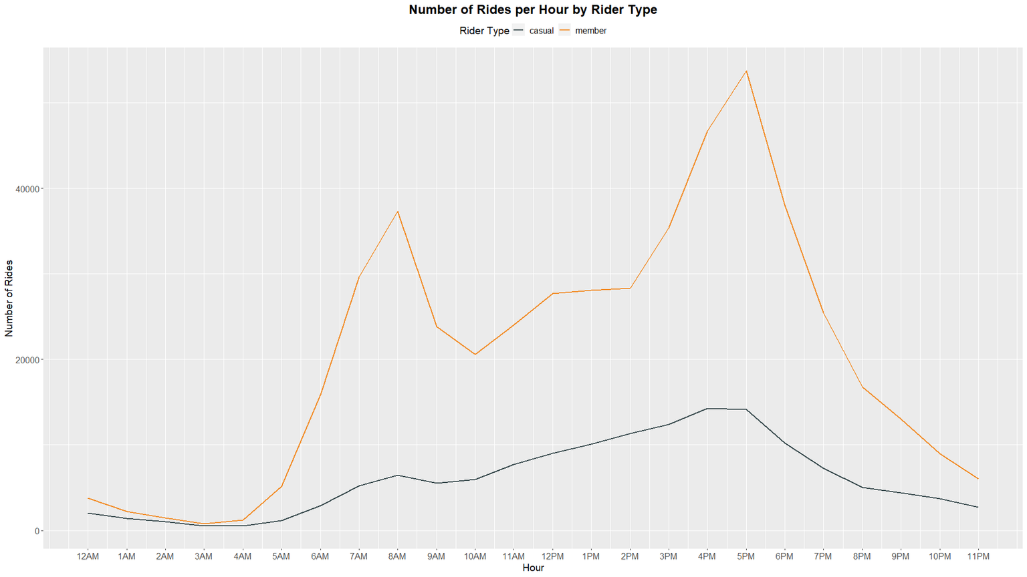

Key Findings : Rush Hours
For Member, the peak time for taking the bike is 8AM and 5PM, where the demand for bike at 5PM is the highest. There is also a sudden peak at 12PM during the lunch hours.
Rush Hour
Lunch
For Casual Riders, peak time is 8AM and after that there is a increasing graph till 4PM which is then straight till 5PM and then starts to decrease.
Members are likely using the bikes for commuting to and from work. Casual riders may be using the bikes more for leisure activities and sightseeing throughout the day.

Slide 9
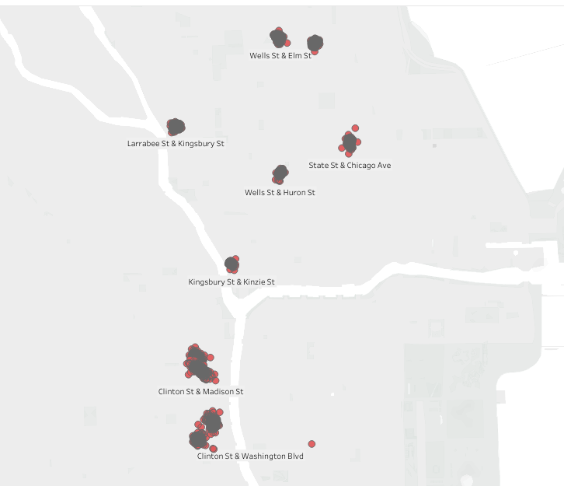
Key Findings : Frequent Starting Points for Casual Riders
For Casual Riders, Clinton St. & Madinson St. and Clinton St. & Washington Blvd points are most popular points to start there ride.

Slide 10

DECISION ACCURACY
IS LESS BECAUSE OF FOLLOWING REASONS
The analysis only considers bike usage data and does not account for other factors that may impact rider behavior, such as weather conditions, seasonality, and events in the city.
The analysis only considers data from Cyclistic's bike-share program and does not account for other modes of transportation that may be used by riders, such as public transit or ride-sharing services.

Slide 11
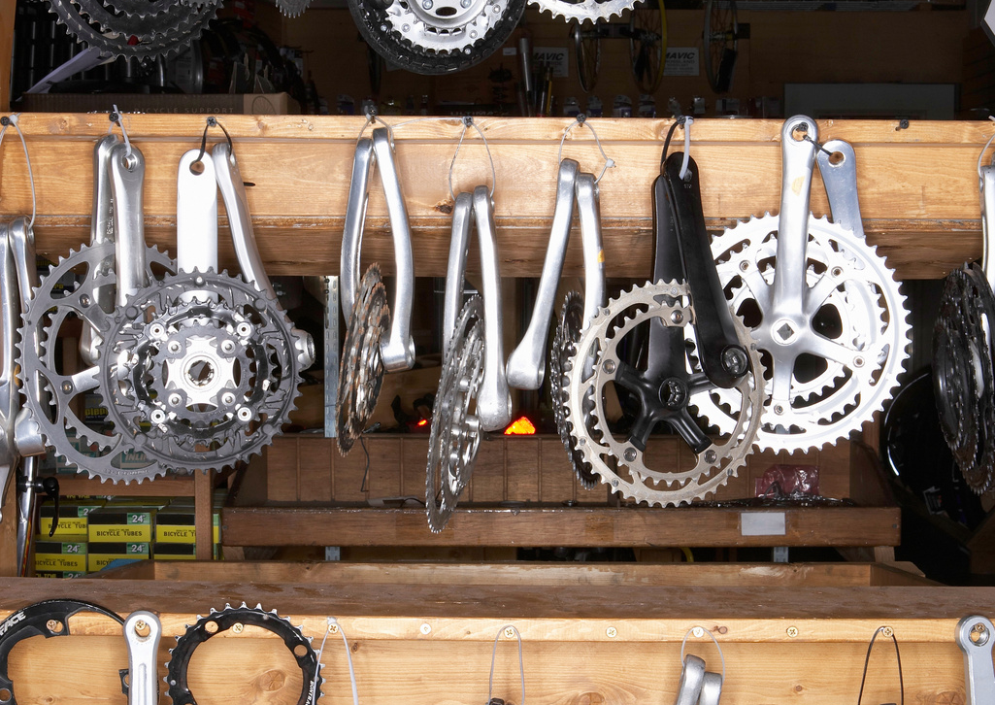
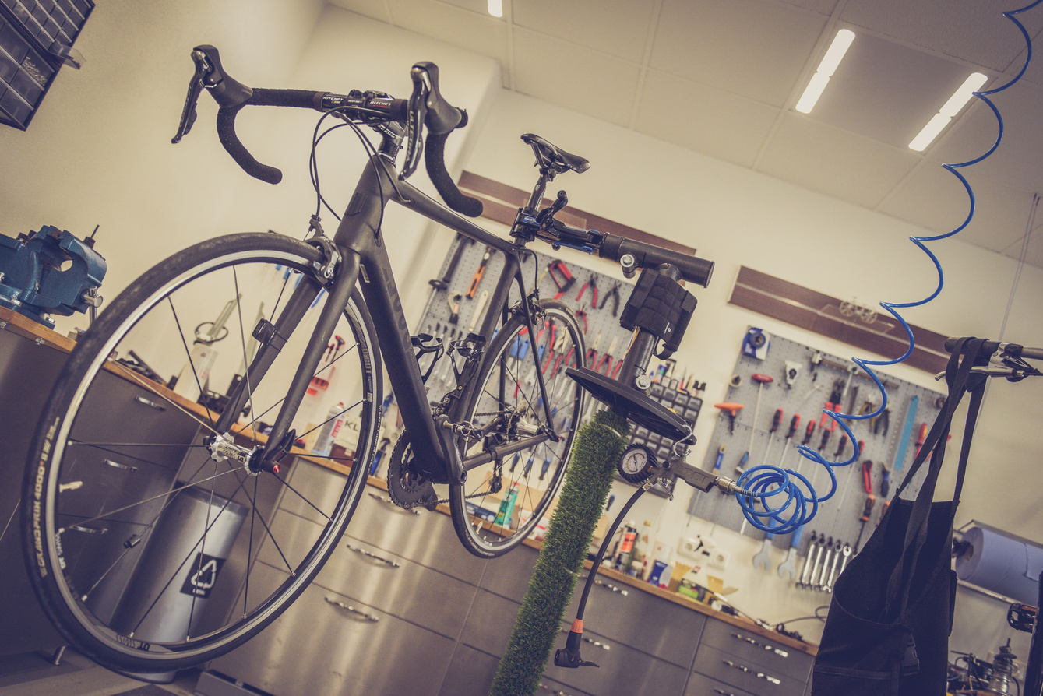

Further Suggestions
CONDUCT SURVEYS OR FOCUS GROUPS
To gather more qualitative data on their behaviors, preferences, and motivations for using the bikes.
GATHER DATA ON THE DEMOGRAPHICS
Such as age, gender, and location, to better target marketing efforts towards specific groups.
ANALYZE THE REVENUE GENERATED
To determine the potential return on investment for marketing efforts aimed at converting casual riders into members.

Slide 12
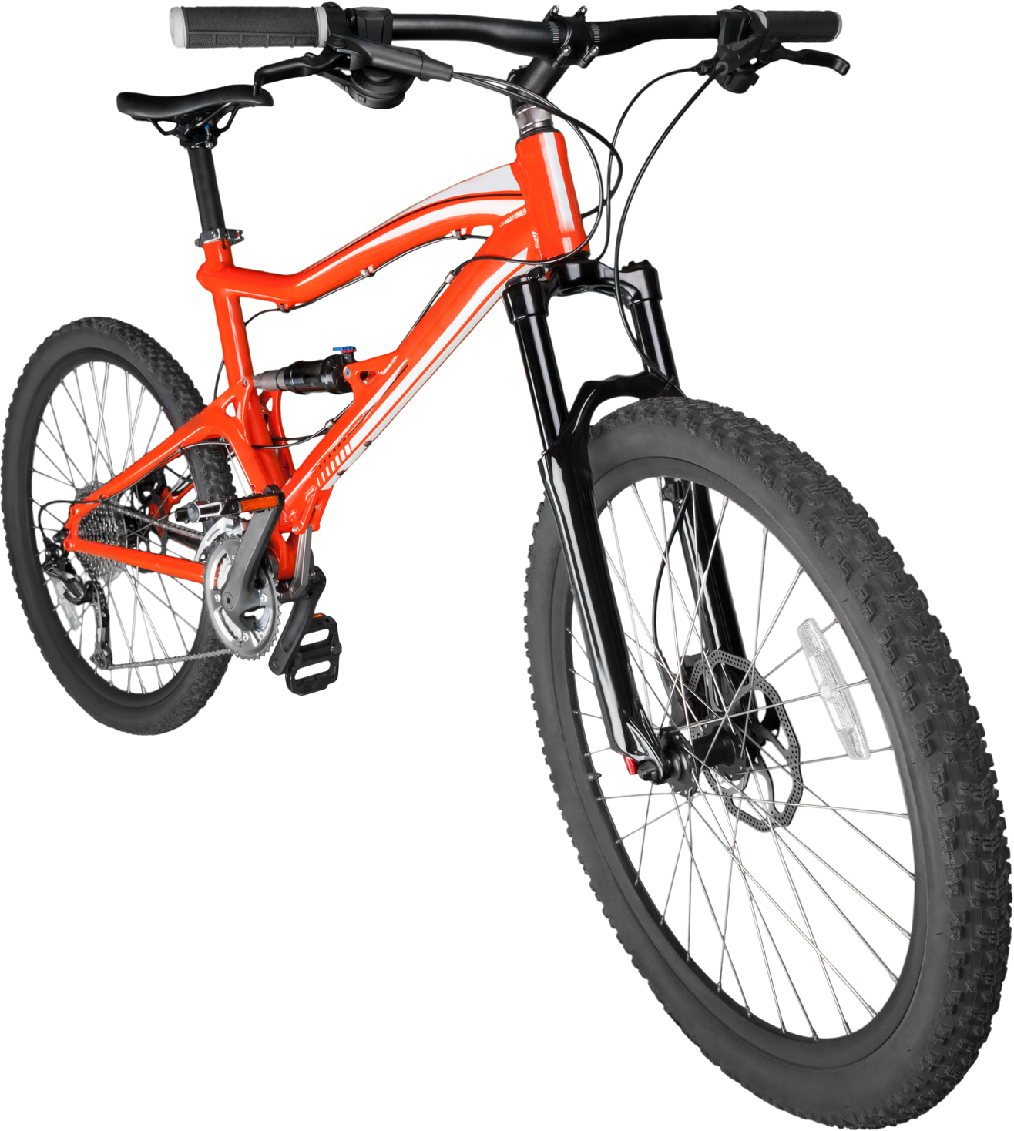
Conclusion
Based on the analysis, casual riders tend to use bikes more during weekends and for longer durations, while members use them during weekdays and for shorter durations. Limitations include limited data on external factors and other transportation modes. Further research is recommended for more conclusive insights.

Slide 13



TOOLS USED
Check Out the Complete Data Analysis Process
HTTPS://DRIVE.GOOGLE.COM/FILE/D/1PTUOPIVTLYS0DDVQHW4WCSOROPHSEAJZ/VIEW?USP=SHARE_LINK

Slide 14

"Insights from data drive better understanding, decisions, and impactful campaigns in marketing."
THANK YOU

